Slide 1
Cognitive Walkthrough

Slide 2
Cognitive Walkthrough
A usability evaluation method in which one or more evaluators work through a series of tasks and ask a set of questions from the perspective of the user.
Understanding the system's learnability for new or infrequent users.
The cognitive walkthrough was originally designed as a tool to evaluate walk-up-and-use systems like postal kiosks, automated teller machines (ATMs), and interactive exhibits in museums where users would have little or no training.
However, the cognitive walkthrough has been employed successfully with more complex systems like CAD software and software development tools to understand the first experience of new users.

Slide 3
Cognitive walkthroughs are used to examine the usability of a product.
They are designed to see whether or not a new user can easily carry out tasks within a given system.
It is a task-specific approach to usability .
The idea is that if given a choice – most users prefer to do things to learn a product rather than to read a manual or follow a set of instructions.

Slide 4
Tasks Become Processes
Tasks are then divided up into a simple process to follow. So, for example, the log in process on a website might look like this:
Open browser
Navigate to site
Click login button
Enter user name in user name field
Enter password in password field
Click the login button

Slide 5
The Four Questions to be Asked during a Cognitive Walkthrough
Blackmon, Polson, et al. in 2002 in their paper “Cognitive walkthrough for the Web” offer four questions to be used by an assessor during a cognitive walkthrough:
  Will the user try and achieve the right outcome?
  Will the user notice that the correct action is available to them?
  Will the user associate the correct action with the outcome they expect to achieve?
  If the correct action is performed; will the user see that progress is being made towards their intended outcome?
  The assessor performs each action in any given task process and asks the four questions above.

Slide 6
Will the user notice that the correct action is available to them
Hidden or obscured controls are a problem for users. The more data that you present and the more choice that you present; the less likely it is that a user will know what to do.
If you bury a control in a menu system rather than having it present while an action is taking place, the same is true; your users won’t know what to do.
One of the most common examples of this in real life is the TV or DVD remote control. These provide an overwhelming number of options to users and are often confusing to use. In many cases manufacturers try to tackle this by placing rarely used functions underneath a sliding cover; by reducing options the control is easier to use.

Slide 7
Will the user associate the correct action with the outcome they expect to achieve?
If your use of language is poor, for example you use overly complex words or industry jargon, it can be hard for a user to work out what is needed to achieve their outcome.
This is also true when you use complex actions (think Ctrl+Alt+Del – it may be something intimately familiar with now – if you use Windows –) to carry out an action.

Slide 8
Benefits, Advantages and Disadvantages
Advantages
May be done without first hand access to users.
Unlike some usability inspection methods, takes explicit account of the user's task.
Provides suggestions on how to improves learnability of the system
Can be applied during any phase of development.
Is quick and inexpensive to apply if done in a streamlined form.

Slide 9
Disadvantages
The value of the data is limited by the skills of the evaluators.
Tends to yield a relatively superficial and narrow analysis that focuses on the words and graphics used on the screen.
The method does not provide an estimate on the frequency or severity of identified problems.
Following the method exactly as outlined in the research is labor intensive.

Slide 10
Who Should Be Involved?
The cognitive walkthrough can be conducted by an individual or group. In a group evaluation, the important roles are:
Facilitator: The facilitator is generally the organizer and is responsible for making sure that the walkthrough team is prepared for the session and follows the ground rules for the walkthrough.
Evaluators: Representatives from the product team. These representatives could be usability practitioners, requirements engineers, business analysts, developers, writers, and trainers.
Notetaker: The notetaker records the output of the cognitive walkthrough.
Product expert: Since the cognitive walkthrough can be conducted early in the design stage (after requirements and a functional specification for example), a product expert is desired to answer questions that members of the walkthrough team may have about the systems features or feedback.
Domain experts: A domain expert is often, but not always a product expert. For example, if you were evaluting a complex engineering tool, you might include a domain expert in addition to product experts.

Slide 11
Procedure
Define the users of the product and conduct a context of use analysis.
Determine what tasks and task variants are most appropriate for the walkthrough.
Assemble a group of evaluators (you can also perform an individual cognitive walkthrough).
Develop the ground rules for the walkthrough.
Some ground rules you might consider are:
  No discussions about ways to redesign the interface during the walkthrough.
  Designers and developers will not defend their designs.
  Participants are not to engage in Twittering, checking emails, or other behaviors that would distract from the evaluation.
  The facilitator will remind everyone of the groundrules and note infractions during the walkthrough.

Slide 12
Procedure . . .
Conduct the actual walkthrough
  Provide a representation of the interface to the evaluators.
  Walk through the action sequences for each task from the perspective of the "typical" users of the product. For each step in the sequence, see if you can tell a credible story based on the following questions (Wharton, Rieman, Lewis, & Polson, 1994, pp. 106):
    Will the user try to achieve the right effect?
    Will the user notice that the correct action is available?
    Will the user associate the correct action with the effect that the user is trying to achieve?
    If the correct action is performed, will the user see that progress is being made toward the solution of the task?
  Record success stories, failure stories, design suggestions, and problems that were not the direct output of the walkthrough, assumptions about users, comments about the tasks, and other information that may be useful in design. Use a standard form for this process.
Bring all the analysts together to develop a shared understanding of the identified strengths and weaknesses.
Brainstorm on potential solutions to any problems identified

Slide 13
The Take Away:
Cognitive walkthroughs are cheap and easy to conduct.
They allow the system or product to be examined for usability from a user’s perspective and provide quick feedback to enable decision making in the design process.
A product does not need to have been developed to conduct a cognitive walkthrough – the walkthrough can take place using sketches or other forms of prototype also. . .

Slide 14
References
https://www.interaction-design.org/literature/article/how-to-conduct-a-cognitive-walkthrough
https://www.usabilitybok.org/heuristic-walkthrough
https://academy.whatfix.com/cognitive-walkthrough/

Slide 15
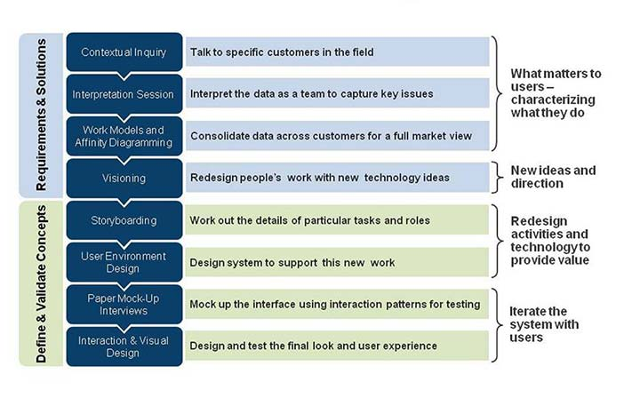
Contextual Design Process

